Slide 1
Final Project Computer Vision (600.461)
N. Belcher, J. Hong, R. Xu

Slide 2
Challenges
Shaky Video
Classification
Multiple Classes
Cars
Taxis, Cars, Motorcycles, Buses
Bicyclists
Pedestrians
Scale, Orientation, and Color

Slide 3
Approach
Video Stabilization
Background Subtraction
Motion Detection
Tracking
Classification

Slide 4
Video Stabilization
Goal: warp frames [2…n] onto frame 1.
Compute SIFT features for every frame.
Compute a homography h that corresponds points in frame i to points in frame 1.
Use h to warp frame i onto the frame 1 space.

Slide 5
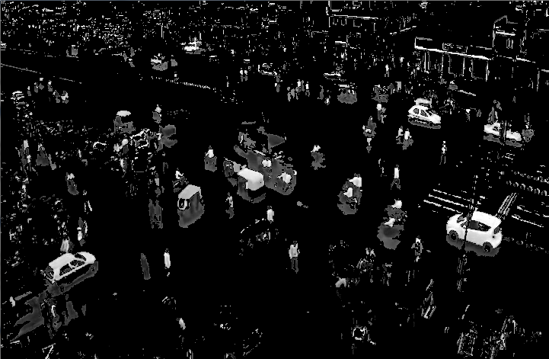
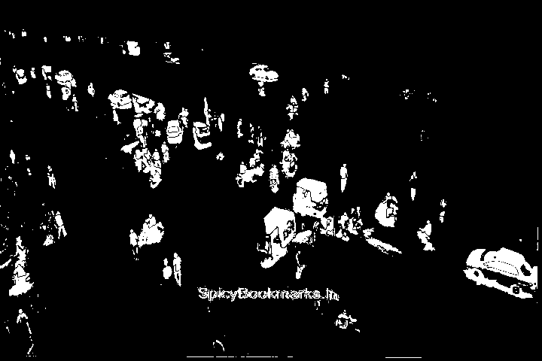
Background Subtraction
Calculate the background (static parts of the video).
Subtract the background from every frame.
Before Stabilization
After Stabilization

Slide 6
Tracking
Step 1: Detection
Detect all the objects in an image
Step 2: Tracking
Update all the objects already being tracked
Step 3: Registration
Update the objects being registered and begin tracking them.
Register the rest of the detected objects

Slide 7
Classification
Training Data
RGB Color Matching

Slide 8
Current Results
Embed Video Here

